Slide 1
SEGMENTATION, TARGETING AND POSITIONING
- MANISH LAMBA

Slide 2
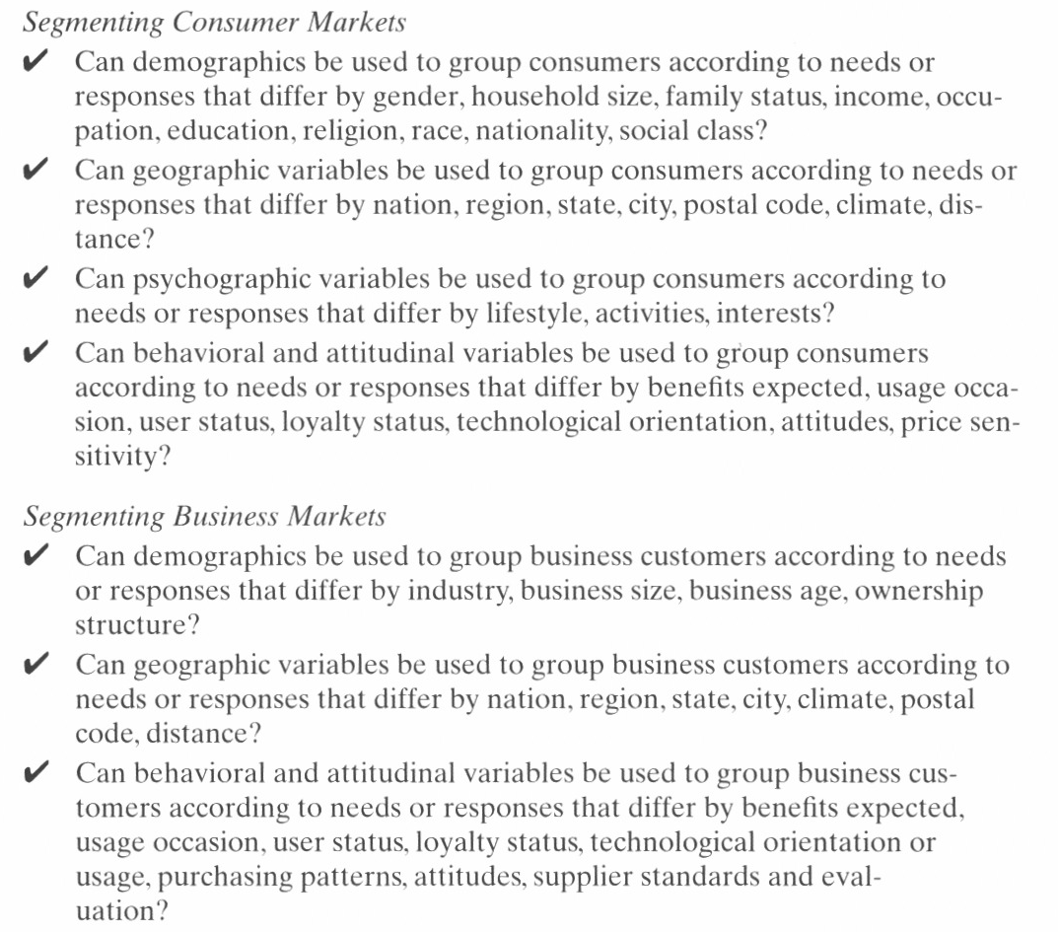

Slide 3

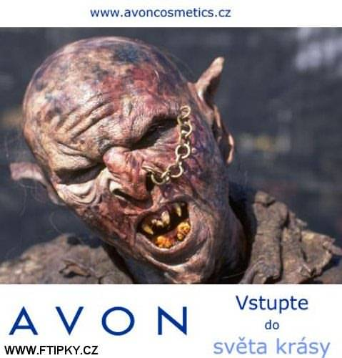
Nivea
Avon

Slide 4
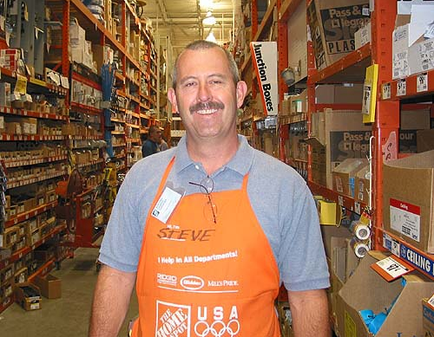

General Workplace
Home Experience

Slide 5
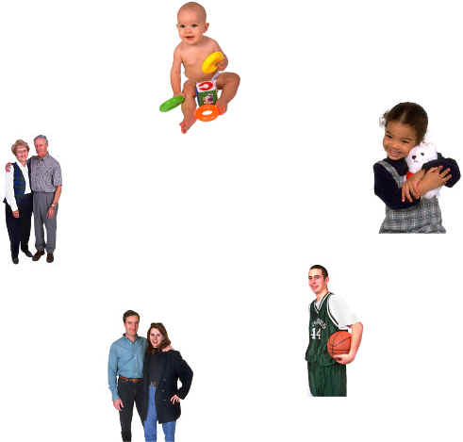
What are some commonly used demographic, geographic and behavioural descriptors ?

Slide 6
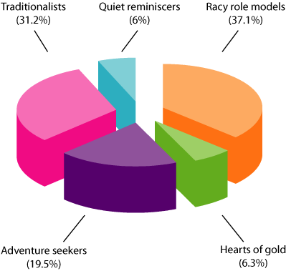
SAGA segmentation of grandparents, where a complete description of each category can be found in this

Slide 7
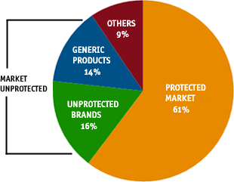
Pharmaceutical Industry Segmentation

Slide 8
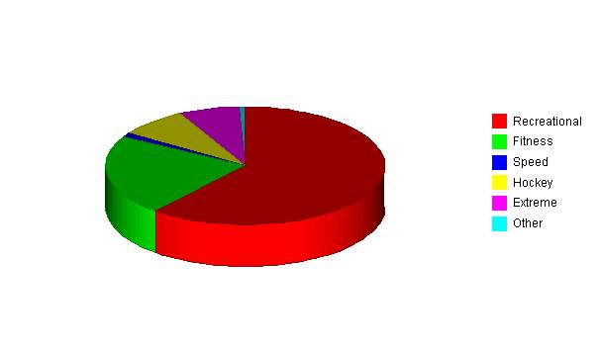
Inline Skating Segmentation

Slide 9
A Useful Tool for Assessing Market Segments : Segment Rating Chart
 | WEIGHT | RATING (0-10) | TOTAL
Market Attractiveness Factors
Customer Needs and Behavior | .5 | 10 | 5.0
Segment Size and Growth Rate | .3 | 7 | 2.1
Macro Trends | .2 | 8 | 1.6
Total: Market Attractiveness | 1.0 |  | 8.7
Competitive Position Factors
Opportunity for Competitive Advantage | .6 | 7 | 4.2
Capabilities and Resources | .2 | 5 | 1.0
Industry Attractiveness | .2 | 7 | 1.4
Total: Competitive Position | 1.0 |  | 6.6
Notes:
Where does the necessary data come from to support the factor ratings?
Primary and secondary marketing research
Analytical frameworks from earlier chapters

Slide 10
The Market Attractiveness /
Competitive Position Matrix
High
(8-10)
●
Market
Attractiveness
Moderate
(4-7)
Low
(0-3)
Low
(0-3)
Moderate
(4-7)
High
(8-10)
Company’s Competitive Position
●
= Market Attractiveness and Competitive Position of distance runners segment
Notes:
How can these factors be assessed?
Market attractiveness factors
Customer needs and behavior: unmet needs?
Segment size and growth rate
Macro trends
Competitive position factors
Opportunities for competitive advantage
Capabilities and resources
Industry attractiveness

Slide 11
Implications of Alternative Positions
Within the Market-Attractiveness /
Competitive-Position Matrix
Competitive Position
Weak
Medium
Strong
Build selectively:
Spec. in limited strengths
Seek to overcome weak.
Withdraw if indications of sustainable growth are lacking
Desirable Potential Target
Invest to build:
Challenge for leadership
Build selectively on strengths
Reinforce vulnerable areas
Desirable Potential Target
Protect position:
Invest to grow at max. digestible rate
Concentrate on maintaining strength
High
Limited expansion or harvest:
Look for ways to expand w/out high risk; otherwise min. invest. and focus operations
Manage for earnings:
Protect existing strengths
Invest to improve position only in areas where risk is low
Desirable Potential Target
Build selectively:
Emphasize profitability by increasing productivity
Build up ability to counter competition
Med.
Market Attractiveness
Divest:
Sell when possible to maximize cash value
Meantime, cut fixed costs & avoid further investment
Manage for earnings:
Protect position
Minimize investment
Protect and refocus:
Defend strengths
Seek ways to increase current earnings without speeding market’s decline
Low
Notes:
14

Slide 12
Concentrated Marketing
  Concentrate on the most attractive segment
Undifferentiated Marketing
  One marketing mix for all
Differentiated Marketing
  Modify marketing mix for different segments

Slide 13

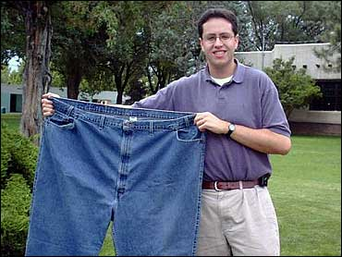
Subway

Slide 14
What is Positioning?
A couple of definitions
  Creating distinct and valued physical and perceptual differences between one’s product and its competitors, as perceived by the target customer.
  The act of designing the firm’s market offering so that it occupies a distinct and valued place in the minds of its target customers.

Slide 15
Generic Competitive Strategies
Competitive Advantage
 | Lower Cost | Differentiation
Broad Target | Cost Leadership Strategy | Differentiation Strategy
Narrow Target | Focus Strategy | Focus Strategy (Differentiation Based)
Competitive
Scope

Slide 16
Comparison of Physical and
Perceptual Positioning Analysis
Physical Positioning
Technical Orientation
Physical Characteristics
Objective Measures
Data Readily Available
Physical Brand Properties
Large Number Of Dimensions
Represents Impact Of Product Specs And Price
Direct R&D Implications
Perceptual Positioning
Consumer Orientation
Perceptual Attributes
Perceptual Measures
Need For Marketing Research
Perceptual Brand Positions And Positioning Intensities
Limited Number Of Dimensions
Represents Impact Of Product Specs And Communication
R&D Implications Need To Be Interpreted
Notes:
2

Slide 17
Levers to Establish Positioning
Simple physically based attributes
  Single physical dimension such as quality, power or size
Complex Physically based attributes
  Concepts like “Roominess” and “User Friendly”
Essentially abstract attributes
  Not directly related to the physical attributes, beauties of perfume, prestige
Price

Slide 18
Steps in the Positioning Process
1. Identify relevant set of competitive products serving a target market.
2. Identify the set of determinant attributes that define the “product space” in which positions of current offerings are located.
3. Collect information from a sample of customers and potential customers about perceptions of each product on the determinant attributes.
Notes:
3

Slide 19
Steps in the Positioning Process
4. Determine product’s current location (positioning) in the product space and intensity thereof.
5. Determine customers’ most preferred combination of determinant attributes.
6. Examine the fit between preferences of market segments and current position of product (market positioning).
7. Write positioning statement or value proposition to guide development and implementation of marketing strategy.
Notes:
4

Slide 20
Value Proposition for a Company
Target Market : Upscale INDIAN Families
Benefits Offered : Safety
Relative Price : 20% premium to domestic family cars
Generic format for value propositions:
  Target Market
  Benefits Offered (and sometimes not offered)
  Relative Price

Slide 21
Some Key Questions
Concerning Positioning Decisions
For whom are they written?
In what sort of language?
Should they focus on features or benefits?
How many differentiating attributes should anchor them?
Notes:
For whom are positioning statements or value propositions written?
An internal audience: marketing decision makers and ad agencies
Should they be written in catchy consumer language or “plain prose?”
Plain prose. The ad agency or other creative staff will develop the catchy consumer language, based on the chosen positioning. Can the class think of examples of catchy current tag lines and the positioning they represent?
Should they focus on features or benefits? Why?
Benefits, which are ultimately why people buy (e.g., safety, for Volvo, vs. side door airbags)
What’s a feature?
A physical attribute of the good or service itself
What’s a benefit?
The end-use consequences that the user will experience by using the product
On how many attributes should one’s positioning be based?
One, or perhaps two at most. No more. Why?
Clear and simple communication
No confusion about what the product stands for.
Examples?
Volvo: Safety. Note there’s more Volvo could say, but here’s where they focus. (One attribute)
Miller Lite beer: Tastes great. Less filling. (Two attributes)
Domino’s Pizza: Originally, fast delivery. Later changed to hot delivery.

Slide 22
A Useful Tool for Positioning Decision Making : Perceptual Maps
Not Sweet
Sweet
Nutritious
Not Nutritious
Where would you plot your favorite cereals ?
Your parents’ favorites ? Your grandma’s?
Notes:
How do you decide what attributes to use as the basis for positioning?
Marketing research
Conjoint analysis
Multidimensional scaling

Slide 23
THANK YOU

